Slide 1
HOTEL MANAGEMENT SYSTEM
SUBMITTED BY
L.RUBEN RAJ
M.RITHVIK

Slide 2
OVERVIEW
1)Efficient Room Management: Easily manage various room types and availability.
2)Guest Management: Maintain guest profiles and preferences for personalized service.
3)Reservation System: Seamless booking process with real-time availability updates.
4)Check-in/Check-out: Streamlined process for quick guest arrivals and departures.
5)Inventory Management: Track and maintain hotel amenities stock levels.
6)Billing and Invoicing: Automated billing with accurate invoicing for transparency.
7)Reporting and Analytics: Gain insights into hotel performance for informed decisions.
8)Integration: Connect with other system for seamless data flow.
9)Security and Privacy: Prioritize data security and compliance with regulations.
10)Scalability and Customization: Flexibility to adopt to evolving needs and growth.
This System aims to Optimize Operations, enhance guest satisfaction, and drive overall efficiency in Hotel Management.

Slide 3
ABSTRACT
The Hotel Management System is a comprehensive solution designed to streamline the
operations of hotels, Offering Efficient Management of Rooms, Guests, and Reservations. With a focus on providing exceptional Guest experiences, the system facilities seamless booking processes, personalized Guests interactions, and efficient Room allocation. key features include real-time room availability updates, Guest profile Management for tailored services, and Automated reservation handling. By integrating these functionalities, the System aims to enhance operational Efficiency, optimize resource utilization, and elevate Guests satisfaction level in the hospitality industry.

Slide 4
KEY FEATURES
1)Room Management: 4)Payment and Billing:
->Track room inventory and status ->Integrate secure payment gateways.
->Allocate rooms efficiently. ->Automate billing processes.
->Implement dynamic pricing. ->Track payment statuses.
2)Reservation Management: 5)Reporting and Analytics:
->Offer user-friendly booking. ->Generate performance reports.
->Automate confirmation and modification. ->Analyze trends and forecasts.
-> Prevent overbooking.
3)Guest Management: 6)Security and Compliance:
->Create detailed guest profiles. ->Ensure data security and PCI compliance.
->Maintain booking history. ->Adhere to regulatory standards.
-> Facilitate communication and feedback.

Slide 5
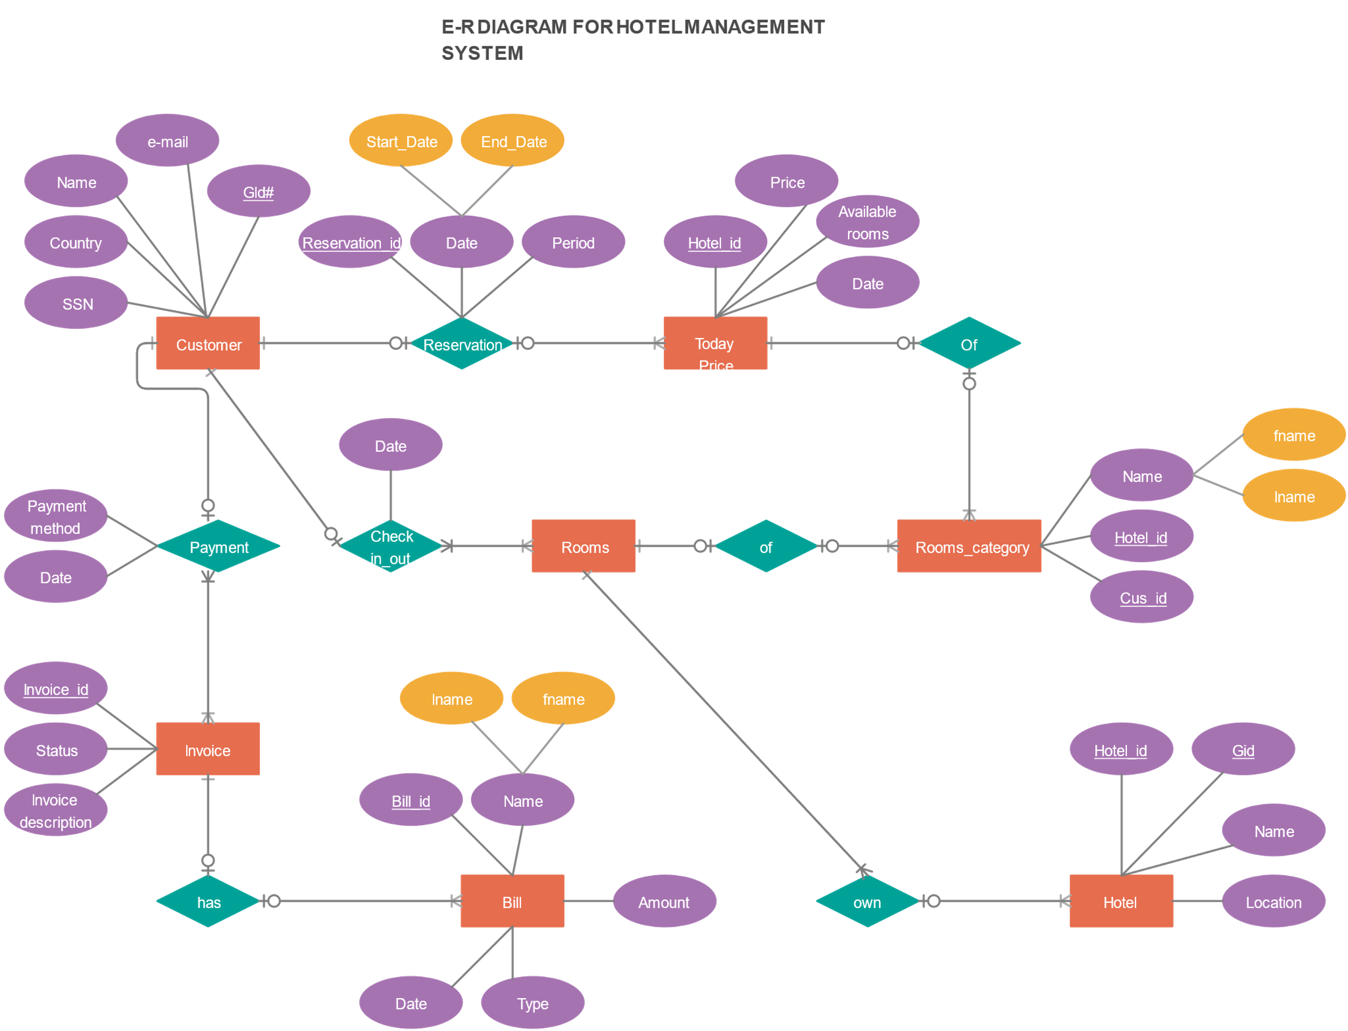
Er diagram for hotel management system

Slide 6
ATTRIBUTES
1)Room Attributes:
->Type, Capacity, Amenities, Status.
2)Guest Attributes:
->Personal info, Preferences, Booking History, Membership Status.
3)Reservation Attributes:
->Booking Details, Status, Payment info, Cancellation Policy.

Slide 7
ENTITIES
1)Room Entity:
-> Attributes: Room number ,Room number, Room type, Capacity, Amenities, Status, Price.
->Functions: Assign room, Update room status, Check room availability, Manage room inventory.
2)Guest Entity:
->Attributes: Guest ID, Name, Contact information, Nationality, Preferences and Membership Status.
->Functions: Create Guest Profile, Record Booking History, manage Guest Preferences, Handle Loyalty Programs.
3)Reservation Entity:
->Attributes: Reservation ID, Guest ID, Room Number, Check-in/out dates, Booking Status, Payment Information, Special Requests.
->Functions: Make new Reservation, Modify Reservation, Cancel Reservation, Handle Payment Details, Enforce Cancellation Policies.

Slide 8
SUMMARY
The Hotel Management system encompasses room, reservation, and guest Management functionalities to streamline Operations and enhance Guest experience. It efficiently handles room allocation, availability tracking, and maintenance Scheduling, ensuring that rooms are well-prepared for guests. Additionally, the system facilitates reservation handling, Allowing Guests to book room seamlessly while updating availability in real-time to prevent overbooking. It also manages Modifications and cancellations swiftly, proving guests with flexibility and convenience. Furthermore, The system maintains A comprehensive database of Guest information, enabling personalized service and efficient check-in/check-out processes. By integrating these key functionalities, The Hotel Management system optimizes operations, enhance guest satisfaction, and Maximizes revenue potential.

